Slide 1
Container

Slide 2

What is container?
a standard unit of software
packages up code and all its dependencies
the application runs quickly and reliably from one computing environment to another.
App
App
System, User, …
System, User, …
System, User, …
Container Image
Kernel
Hardware

Slide 3

What is container & Docker?
Containers uses the resource isolation features of the Linux kernel
cgroups and kernel namespaces
a union-capable ﬁle system (such as OverlayFS)
A control group (cgroup) is a Linux kernel feature that limits, accounts for, and isolates the resource usage (CPU, memory, disk I/O, network, and so on) of a collection of processes
Namespaces are a feature of the Linux kernel that partitions kernel resources such that one set of processes sees one set of resources while another set of processes sees a different set of resources
NOT
So, Container is Docker :)

Slide 4
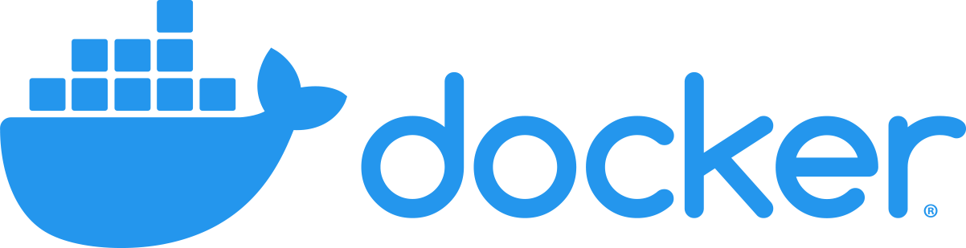
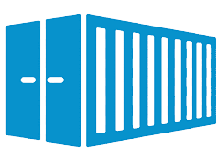
Docker & Container relation
Something
App
System, User, …

Slide 5
What is Something?
We need something to run containers ⇒ Container runtimes
Let’s dive in before taping toe in water
What happens if we run something like this:
docker run -p 8080:8080 -e KAFKA_CLUSTERS_0_NAME=snapp-box -e KAFKA_CLUSTERS_0_BOOTSTRAPSERVERS=<SOME_IP>:<SOME_PORT> provectuslabs/kafka-ui:latest
It will creates and run a container for us as we told it
HOW?

Slide 6
Step by step overview of HOW
The image is pulled from an image registry if it not available locally
The image is extracted onto a copy-on-write filesystem, and all the container layers overlay each other to create a merged filesystem
A container mount point is prepared
Metadata is set from the container image, including settings like overriding CMD, ENTRYPOINT from user inputs, setting up SECCOMP rules, etc., to ensure container runs as expected
The kernel is alerted to assign some sort of isolation, such as process, networking, and filesystem, to this container (namespaces)
The kernel is also alerted to assign some resource limits like CPU or memory limits to this container (cgroups)
A system call (syscall) is passed to the kernel to start the container
SELinux/AppArmor is set up
Container runtimes take care of all of these

Slide 7
Container runtimes
Main focus here are:
Running containers
Setting up namespaces and cgroups
Examples:
containerd
cri-o
runc
Everyone can implement these as they want; so standards are in order
Notes:
Can you give us another example? → lxc

Slide 8
Open Container Initiative (OCI)
Purpose: to design certain open standards or a structure around how to work with container runtimes and container image formats.
Two specifications:
image-spec
Goal: to enable the creation of interoperable tools for building, transporting, and preparing a container image to run.
runtime-spec
Goal: to define the configuration, execution environment, and lifecycle of a container

Slide 9
A little detour: Container Runtime Interface (CRI)
CRI is a Kubernetes API; we will discuss K8S in details later on.
CRI defines the way that K8S interacts with different container runtimes.
Before CRI (K8S version 1.5), the most likely container runtime choice for K8S was Docker.

Slide 10
Docker & Container relation
Container runtimes
Something
App
System, User, …

Slide 11


Docker & Container relation
almost
This is current Docker architecture
Why 2 different components?
Which one is container runtime?

Slide 12
containerd - RUNC
Which one is container runtime?
Both
High Level Container Runtime
Low Level Container Runtime
OCI standard
OCI standard
Sits above the low level runtime
It uses the native features of Linux to create and run containers
Adds a bunch of features, like transferring images, storage, and networking
it includes libcontainer, a Go library for creating containers

Slide 13
Docker architecture
gives user the ability to interact with the Docker daemon using docker ... commands. This lets you control containers without needing to understand the lower levels
docker cli
docker daemon
a daemon process which provides a standard API, and talks to the container runtime

Slide 14
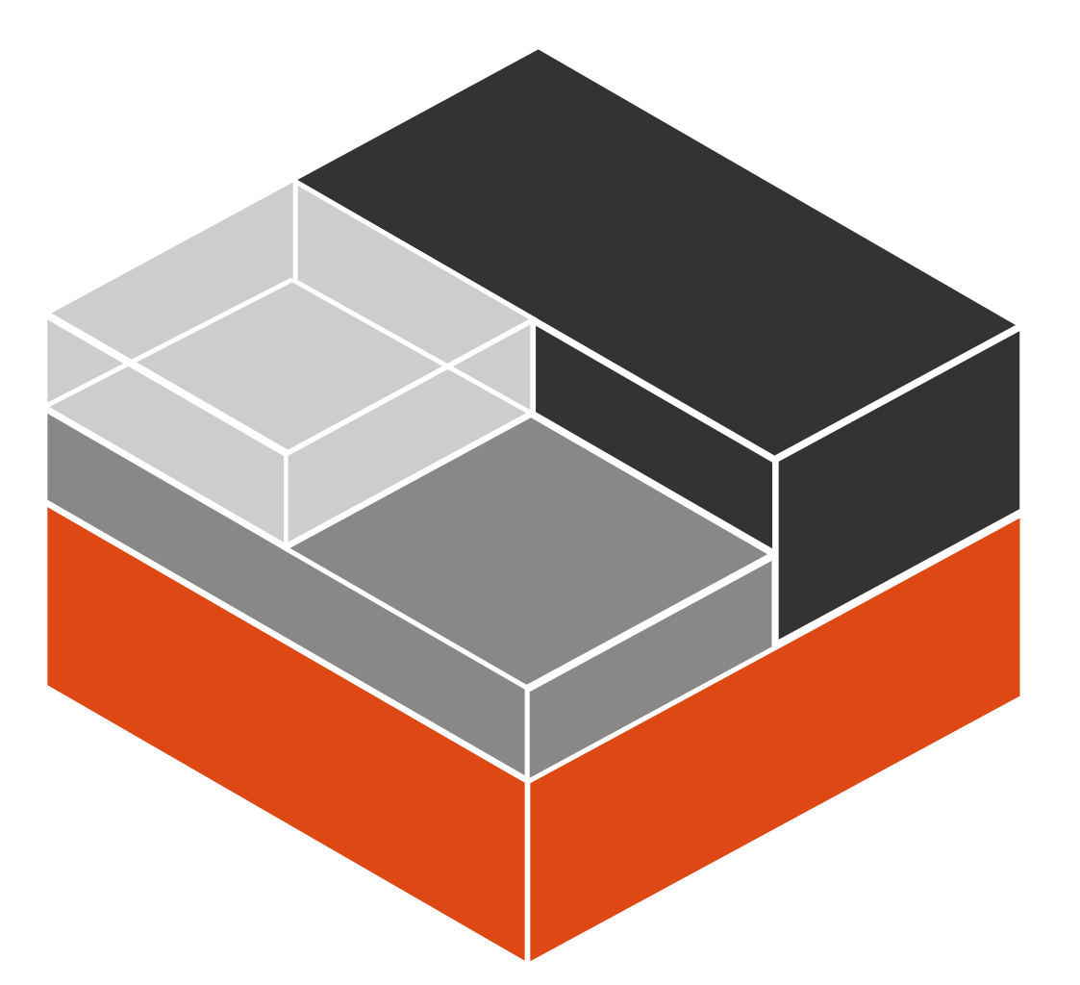
History: Old Docker architecture
What was wrong with this?
Why they changed it?
docker cli
In that time, there were no standard to follow
2002: namespace
docker daemon
2007: cgroup
This architecture is not OCI & CRI compatible
2008: LXC
2013: Docker
This architecture will not work with K8S !!
2014: Kubernetes
Is this a true statement?
Notes:
Is this a true statement?: Yes & no. K8S formed around docker right after container fever caused by Docker. But after awhile, as we said, everyone started to come up with their own container management system and standardization was required. After introduction of these 2 standards, everyone was supposed to follow them which caused a foundation of Docker’s new architecture.

Slide 15
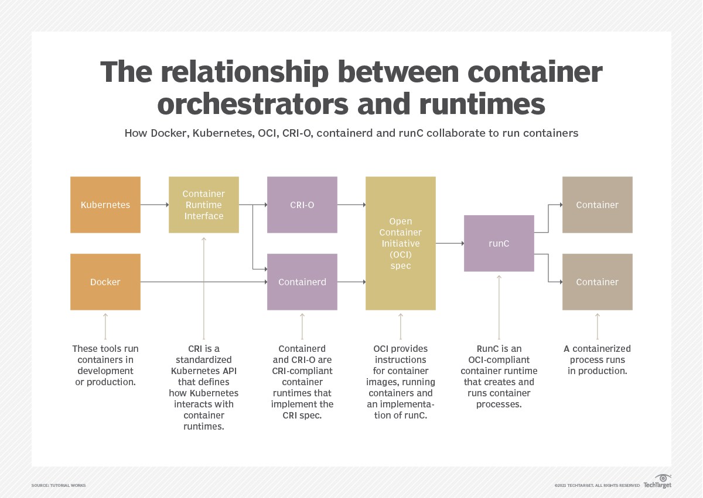
Big picture
Notes:
The diagram, not the picture itself :D
I know i’m not funny :))))

Slide 16
Docker
We are going to use Docker documentation | Get started as reference here
Why not just going through with this doc?
I’m going to push you a little bit more
Let’s divide it into different stages:
Image & Registry
Dockerfile
docker cli (except compose)
docker compose

Slide 17
Image
In the first slide: packages up code and all its dependencies → container image
Some packages should be installed
Some default configuration/variables may needed
Some commands may required to run
Some files/binaries may needed
Some networking may required
…
App
System, User, …
We also need to have something that enables us to move this package around and run it wherever we want
Image is that something which gives us all above criteria

Slide 18
A little bit of detour
Development Time
Build Time
Docker image creates here
Runtime
To be used here

Slide 19
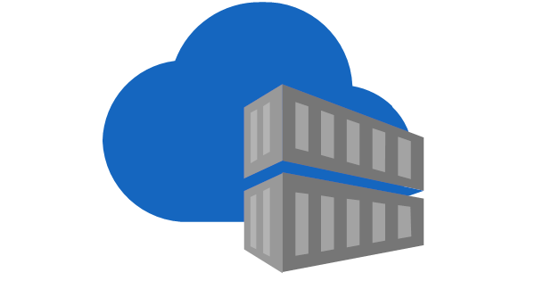


[Image] Registry
Where could we keep these images?
How to shared them with others?
How could we ship them?
App
System, User, …
Public
Private

Slide 20
Image
SOME_DOMAIN:SOME_PORT/SOME_URI/IMAGE_NAME:IMAGE_TAGE
This part is hidden for docker hub
Optional
We could say that this is the application that you want
And this its version
This will tell docker where to go (which registry) to interact with the image

Slide 21
Dockerfile
FROM node:18-alpine
WORKDIR /app
COPY . .
RUN yarn install --production
CMD ["node", "src/index.js"]
EXPOSE 3000
Base image
It’s like you used a permanent “cd” command
Copy something from system to container
Run any command that available here
Default parameters that executed when container runs
Just to be remember that this app will use this port
Each of these steps, creates a layer
Layers help us to skip any step that didn’t change since last time
If a layer changes, none of the cached layers remain valid from there forward

Slide 22
Dockerfile: Another example
FROM nexus.DOMAIN:PORT/dockerhub/alpine:3.18.0
ENV TZ="Asia/Tehran"
RUN apk update --no-cache \
&& apk add --no-cache \
python3 \
py3-pip \
&& rm -rf /var/cache/* \
&& rm -rf /root/.cache/* \
&& pip3 install --no-cache-dir --upgrade pip \
&& ln -snf /usr/share/zoneinfo/$TZ /etc/localtime \
&& echo $TZ > /etc/timezone
COPY ["requirements.txt", "some-python.py", "/"]
WORKDIR "/"
RUN pip3 install -r requirements.txt
ENTRYPOINT python3 some-python.py
Dockerfile reference if you want to learn them all
ENTRYPOINT vs CMD
Both default parameters for runtime
CMD allow you to override it while running container

Slide 23
docker cli
docker login -u USERNAME --password-stdin ADDRESS_OF_REGISTRY
docker build <SOME_OPTION> -t IMAGE_COMPLETE_ADDRESS DIR_OF_DOCKERFILE
docker pull IMAGE_COMPLETE_ADDRESS
docker push IMAGE_COMPLETE_ADDRESS
docker tag ORIGINAL_IMAGE_COMPLETE_ADDRESS DESIRE_IMAGE_COMPLETE_ADDRESS
docker run -p HOST:CONTAINER -e SOME_ENV SOME_IMAGE SOME_CMD_IF_WANTED
docker ps
docker logs SOME_OPTIONS (like -f or --tail 100) CONTAINER_NAME_OR_ID
docker exec -it CONTAINER_NAME_OR_ID COMMAND_TO_EXECUTE
docker rm CONTAINER_NAME_OR_ID
docker rmi IMAGE_COMPLETE_ADDRESS
docker stop CONTAINER_NAME_OR_ID
docker kill CONTAINER_NAME_OR_ID
docker restart CONTAINER_NAME_OR_ID
docker cp SRC DST (one of them is a container → CONTAINER_NAME_OR_ID:/PATH)
docker image SOME_COMMANDS (like ls)
docker network SOME_COMMANDS (like ls)
docker volume SOME_COMMANDS (like ls)
docker compose … → We will talk about this later

Slide 24
docker compose
We saw that we can run containers with command “docker run …”
But this is not permanent and we will forget what we did executed
We can use “docker compose” to do the same as fix above issue
Consider this “docker run” command:
docker run -p 8080:8080 -e KAFKA_CLUSTERS_0_NAME=snapp-box -e KAFKA_CLUSTERS_0_BOOTSTRAPSERVERS=KAFKA_IP:9092 provectuslabs/kafka-ui:latest
Port
Environment variable
Environment variable
Image
version: "3.7"
services:
MY_APP_NAME:
image: provectuslabs/kafka-ui:latest
ports:
- 8080:8080
environment:
- KAFKA_CLUSTERS_0_NAME=snapp-box
- KAFKA_CLUSTERS_0_BOOTSTRAPSERVERS=KAFKA_IP:9092
restart: always
In the same directory as the file:
docker compose up -d
docker compose down
docker compose restart
docker compose ps
This is “docker-compose.yml” file

Slide 25
Volume
As we said, containers are isolated from their host
So if any data written into a container, as long as that container live, the data exists
In another word, if a container die, all of its data will loss
To prevent this, we can attach one or several volumes to any container
There are 2 ways to do this:
Using “docker volume create VOLUME_NAME” command and pass it to a container
Attach a path from host to a path in container

Slide 26
Network
Like volumes, container’s network are also isolated from host
This is why we have to specify a combination of host port and container port to be able to access any container’s port
The default behaviour of docker is that for any “docker run” or “docker compose” command, it will create a separate network
What if we want to connect a new container to another container’s network?
What if we want to add multiple container into a single “docker-compose.yml” file?
All of this OK and possible
P.S.: If you have multiple containers in a single “docker-compose.yml” file, not only they all uses the same network, their container names are all resolvable inside that network

